Slide 1

AIML Group Lab Team-7
AI Solution for Changing Weather Conditions

Slide 2
Agenda
Problem Statement
Introduction to Team
Response to the Questionnaire (Refer Abstract)
Business Applications, Post course
Q & A

Slide 3
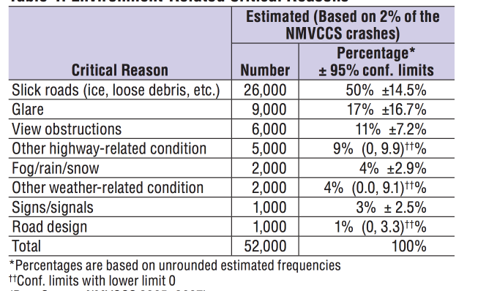
Problem Statement
8% of road accidents and fatalities reported are due to bad/abnormal weather conditions which were not detected by existing solutions and same needs to be addressed by Intelligent Solutions
To reduce road accidents from 8% to Nil by implementing Artificial Intelligence System which will dynamically adjust to weather appropriate driving styles

Slide 4
Team (K3GVD)
Kalyan
Karthik
Kaushik
Girishankar
Vinay
Dhiren

Slide 5
Key Facts about Proposed AI Solution
Data Set Required?
KITTI (Toyota)
IDD
City Scapes
Problem Type?
Classification-Supervised Learning
Deficiencies in available data?
Drastic weather condition data availability
“Definition of corner case”
Data representation?
Feature Extraction using Transfer Learning
Metric for solution effectiveness?
F1Score=(2*(Precision*Recall)/(Precision Recall)
Algorithm Proposed for Problem Solving?
Deep Learning using CNN

Slide 6
Answers to the Questionnaire (Algorithms)
Feature Extraction
Scanning Stage
X
Beta
Classification
Y=f(X,Beta)
Avg Probablity <0.3?
Translate Image to regular condition
Yes
Decision Making Stage
No
Softmax
Action Stage

Slide 7
Two Mode Solution
Machine Mode (Autonomous Driving)
1
Human Mode (Human Takes over.Corresponding data used for further learning)
2

Slide 8
Q & A

Slide 9
Thank you!

